Slide 1


Ethical Decision Making
Steve Chenoweth
Session 10, Part 2
Notes:
Image from http://www.acfe.com/ethics-and-compliance.aspx.

Slide 2
Big question – “What should you do”?
In real world situations, usually –
  The outcomes aren’t completely clear. And,
  There are downsides to any action. And,
  Your role isn’t definitive.
    E.g., You notice a problem, but you’re not in charge.
A classic example of “double efffect,” from philosopher Philippa Foot (1967) →
Notes:
A good resource on the problem, http://www.philosopherstoolkit.com/the-trolley-problem.php.

Slide 3
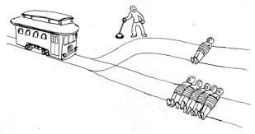
The Trolley Problem
Trolley is coming. It’s going to crush five people.
You can move the lever, to doom only one person, instead.
Group activity: What would you do?
Notes:
Image from https://advocatusatheist.wordpress.com/2011/10/24/the-trolley-problem-a-thought/

Slide 4

But wait…
New problem – You are a surgeon. You have people sitting in your waiting room, who will die without transplants.
The guy in the middle is completely healthy. His organs would prevent the death of everyone else in the room.
  And he’s kind of old,
  anyway.
  What would you do?
Notes:
Image from http://decorationavenue.blogspot.com/2014/05/gp-waiting-room-chairs.html. https://www.google.com/url?sa=i&rct=j&q=&esrc=s&source=images&cd=&cad=rja&uact=8&ved=0CAcQjRw&url=http%3A%2F%2Fdecorationavenue.blogspot.com%2F2014%2F05%2Fgp-waiting-room-chairs.html&ei=FRZKVb71JomtyAS2-oBI&psig=AFQjCNFiafPzpOlc2DVHhOrBocWr78xaKA&ust=1431005069979852

Slide 5
What ethics is
Systematizing, defending, and recommending concepts of right and wrong behavior.
Metaethics investigates where our ethical principles come from, and what they mean.
Normative ethics takes on a more practical task, which is to arrive at moral standards that regulate right and wrong conduct.
Applied ethics involves examining specific controversial issues, using the above two.
Notes:
From http://www.iep.utm.edu/ethics/

Slide 6
We have normative ethics for software
The IEEE Code:
to accept responsibility in making decisions consistent with the safety, health, and welfare of the public, and to disclose promptly factors that might endanger the public or the environment;
to avoid real or perceived conflicts of interest whenever possible, and to disclose them to affected parties when they do exist;
to be honest and realistic in stating claims or estimates based on available data;
to reject bribery in all its forms;
to improve the understanding of technology; its appropriate application, and potential consequences;
to maintain and improve our technical competence and to undertake technological tasks for others only if qualified by training or experience, or after full disclosure of pertinent limitations;
to seek, accept, and offer honest criticism of technical work, to acknowledge and correct errors, and to credit properly the contributions of others;
to treat fairly all persons and to not engage in acts of discrimination based on race, religion, gender, disability, age, national origin, sexual orientation, gender identity, or gender expression;
to avoid injuring others, their property, reputation, or employment by false or malicious action;
to assist colleagues and co-workers in their professional development and to support them in following this code of ethics.
The ACM Code is similar.
Notes:
From http://www.ieee.org/about/corporate/governance/p7-8.html.
The ACM code is at https://www.acm.org/about/code-of-ethics.

Slide 7
So, we can apply this in our work.
Group activity: What should you do in the following situation:
Originally our customer asked for a sophisticated product upgrade, targeted to be used by their existing, experienced group of users. We created the feature set so that experts could make the most efficient use of the upgraded system.
The customer later decided their product also needed to operated by a wider group of occasional users, who lacked the background of the originally targeted user group. Our most recent, sophisticated features could easily be used incorrectly by this new set of users, because there was no additional training requested to go with the upgrade.
How much obligation do we have, to prevent possible damage resulting from the misuse of our product?

Slide 8
Project management ethics
Project Management Institute has a more elaborate set of ethical standards for PM’s.
At the same time, it can result in cloudy guidance because of this large scope. E.g., consider the following section. →
Notes:
See http://www.pmi.org/About-Us/~/media/PDF/Ethics/PMI-Code-of-Ethics-and-Professional-Conduct.ashx.

Slide 9
3.2 Respect: Aspirational Standards
As practitioners in the global project management community:
  3.2.1 We inform ourselves about the norms and customs of others and avoid engaging in behaviors they might consider disrespectful.
  3.2.2 We listen to others’ points of view, seeking to understand them.
  3.2.3 We approach directly those persons with whom we have a conflict or disagreement.
  3.2.4 We conduct ourselves in a professional manner, even when it is not reciprocated.
Typical issue: In order to sell a product in another country, you have to give a bribe to a government official who controls licensing. This is against your company code of ethics, but follows the country’s code of ethics. You discover the problem after committing resources to the project.
Your vice president suggests that the transaction be completed through a third party, so as to avoid a direct conflict.

Slide 10
Project Management Application
Group activity: What should you do in the following situation:
You have been asked to provide a project update at the next client meeting. You start putting together a presentation and highlight a high probability of delay and not being able to meet some of the client’s requirements.
The sales executive asks to review the presentation and sends it back after deleting the key points about delays and issues. He comments that you only need to highlight the positive accomplishments or else the company will not win a related project that it is bidding for.
Do you go along with the sales executive’s recommendation? Do you highlight the truth in the client briefing? Do you ask to be excluded from the meeting?
Notes:
From http://www.pmi.org/About-Us/Ethics/What-Do-You-Do-When-You-Face-Tough-Dilemmas.aspx.

Slide 11
Typical recurring PM issues
“Wired” bids and contracts (the winner has been pre-determined),
“Buy-in” (bidding low with intent of cutting corners or forcing subsequent contract changes),
Kickbacks,
“Covering” for team members (group cohesiveness),
Taking “shortcuts” (to meet deadlines or budgets),
Using marginal (substandard) materials,
Compromising on safety,
Violating standards, and
Consultant loyalties (to employer or to client or to public).
Notes:
From http://www.ewh.ieee.org/reg/7/canrev/cr45/pages6-8.pdf.

Slide 12
Why the PM is in a tougher spot
If the project manager is at fault for the unsuccessful venture of project completion, then that project manager must be able to admit this wrong.
Not admitting wrongdoing can greatly damage the team relationship.
The unethical practice will also most likely cause the team members you are in charge of to not trust the manager as well.
Notes:
From http://www.brighthubpm.com/project-planning/53025-ethical-issues-in-project-management/.

Slide 13
Why the PM is in a tougher spot, cntd
When a project fails, it is so much easier to point the fingers at this person or that person.
However, ethically, no person should be singled out for project failure unless it is the project manager. In the end, he or she is the one assigned the ultimate task of ensuring the project is completed.
However, there is no “I” in team. Although the project manager is in charge of ensuring the task gets completed, sometimes a task can fail despite the project manager’s best efforts. In these cases of project incompletion or failure, it should be said that the team failed.

Slide 14
The case study
Was it clear what Wayne Davidson should have done, as you read this?
Was it clearer after looking at the IEEE code of ethics, for example?
Group activity: What was the first unethical act, and what would you have done differently?
Notes:
From http://www.scu.edu/ethics/practicing/focusareas/technology/occidental_engineering/occidental_engineering.html.

Slide 15
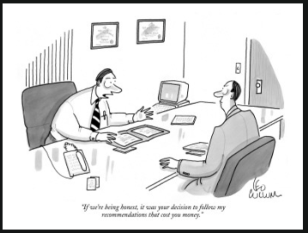
Why it’s not easy
In any project / engineering situation, there are many ways to look at it.
There will be inherent disagreements depending on self-interests and
group interests.
And, as I say that,
my project is
“90% done.”
Notes:
Cartoon from http://www.condenaststore.com/gallery.asp?startat=%2Fgetthumb.asp&txtSearch=ethics.

Slide 16
Frames of reference
These lead to different conclusions.
Which brings us back to “metaethics.”
  Especially the psychological basis for moral judgments and conduct.
  What motivates us to be moral?
    Avoid punishment?
    Gain praise?
    Achieve happiness?
    Be dignified?
    Fit in with society?
Notes:
From http://www.iep.utm.edu/ethics/.

Slide 17
Egoism vs Altruism
Engineering is supposed to show benevolence to others.
People in compromised situations often argue away from this, that everything is inherently selfish, thus an option that’s more selfish, but compromised, isn’t so bad.
Or, that there are other parties they care about, who would be hurt if they didn’t act in a way contrary to the greater good.
  Employees would be hurt if we admitted we delivered a bad product…
Notes:
From http://www.iep.utm.edu/ethics/.

Slide 18
Emotion vs Reason
Is all ethics based on emotion?
  We do tend to feel emotional about these choices.
  David Hume argued all moral assessments involve our emotions, not reason.
  Evidence: On topics of morality, people tend not to be swayed by the other side’s reason.
  Immanuel Kant, in contrast, argued that we should resist emotional sway. True moral action is motivated by reason.
  Evidence: We expect moral judgments to be backed up by reasonable explanations supporting actions.
Notes:
From http://www.iep.utm.edu/ethics/.

Slide 19
Gender considerations
Traditional morality is male-centered valuing:
  Acquiring property
  Engaging in business contracts
  Governing societies
    Rigid systems of rules required for these actions.
  Ignores the morality of spontaneously helping others.
    In women’s experience, the agent becomes part of the situation, and acts caringly within that context.
    Versus a mechanical actor who performs his duty, but can be distanced from and unaffected by the situation.
Notes:
From http://www.iep.utm.edu/ethics/.

Slide 20
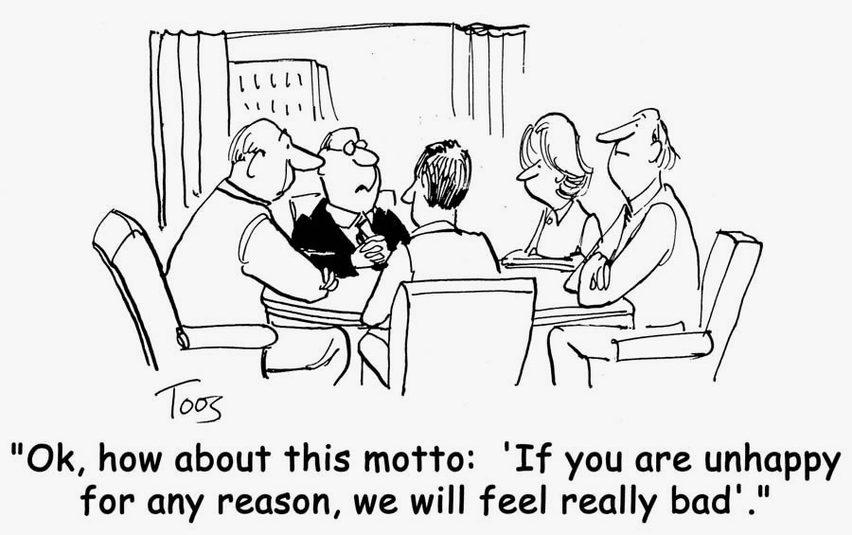
Frames of reference to consider
“Be the customer”:
  Go visit their environment, spend a day with them.
  Understand why they have the values they do.
  Try to step through a scenario in their shoes.
  Come back and explain it to your colleagues!
“Be the user”:
  Ditto the above steps.
“Be whoever else it’s about”:
  Ditto the above steps.
Notes:
Cartoon from http://iwantitnow.walkme.com/cartoon-customer-service-nothing-to-fool-about/

Slide 21
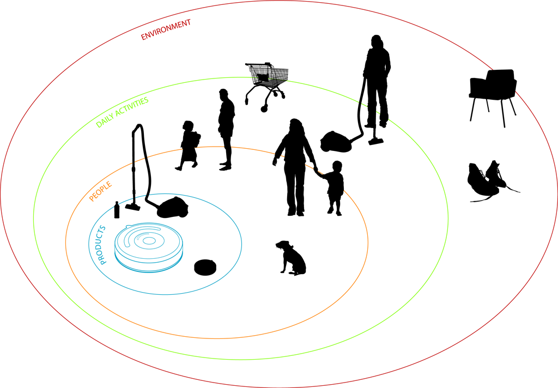
Example
An “ethnographic study” on the Roomba in Italy!
A wider perspective even than Conops…
A setup for getting to Conops, without losing anything.
Notes:
Conops typically is “the characteristics of a proposed system from the viewpoint of an individual who will use that system.”
Image from https://korayozsoy.wordpress.com/2010/12/12/an-ethnographic-study-on-the-roomba-vacuum-cleaner-in-the-domestic-environment-in-italy/

